Slide 1
Interval Scheduling, Reservations, and Timetabling
IE 419

Slide 2
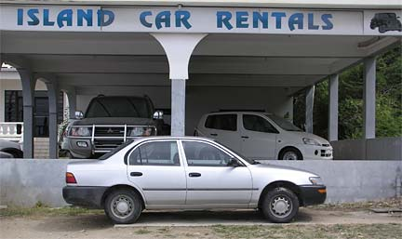
Reservation Systems
Hotel rooms, car rentals, airline tickets (and classroom scheduling)
You want to have the use of a resource for a given period of time
With slack: p_{j} < d_{j} – r_{j}
Without slack p_{j} = d_{j} – r_{j}
May not be able to schedule all requests

Slide 3
Reservation Systems without Slack
Reservation system with m machines, n jobs
Release date r_{j} , due date d_{j} , weight w_{j}
No slack
If processed , job must start at time r_{j}
Should we process the job?
Possible objectives
Maximize $$
Maximize resource usage
Minimize number of rejected requests
Minimize $$ of rejected requests

Slide 4
Reservation Systems without Slack Example: A Car Rental
Four types of cars: subcompact, midsize, full size, and sport utility
Fixed number of each
Machine = type of car
Job = customer requesting a car
May request certain machine(s)
Job can be processed on a subset of machines, M_{j}
Midsize substituted for subcompact leads to profit based on machine assignment
w_{ij} = (q_{j} – c_{i}) * p_{j}
q_{j} is the price charged per day to customer j
c_{i} is the cost (to the rental agency) per day of a car in class i
… weights can be job and machine dependent
Yield management

Slide 5
Reservation Systems without Slack
Feasibility Problem
Can we process every job?
Can we assign jobs to machines such that job j is assigned to a set M_{j} of machines?
Both relatively easy to solve
Problem Formulation
General problem is hard
Special cases are easy
All activities have duration of 1 – independent problem for each time slot
Decomposition by time unit t and Assignment Problems are solved
All weights are 1, all resources in a single set, durations are arbitrary
Maximize the number of scheduled activities

Slide 6
Reservation Systems without Slack Problem Formulation
Integer Programming Problem
Fixed time periods, t = 1 … H
Let x_{ij} be 1 if job j assigned to i th machine (and zero otherwise)
Every activity is assigned to at most one resource
Jobs requiring
processing in
period t
Each resource has only
one activity per time slot

Slide 7
Reservation Systems without Slack Identical Weights and Machines
Assume w_{j} = 1, arbitrary p_{j} , and M_{j} = {1,2,…,m}
Does not have a time decomposition
Simple algorithm maximizes number of jobs that are processed
Order jobs in increasing release date order

Slide 8
Reservation Systems without Slack Algorithm
Step 1
Set J=∅ and j=1
Step 2
If a machine available at time r_{j} assign job j to the machine, include it in J and go to Step 4
Step 3
Select j * such that
If do not include j in J and go to Step 4
Else delete job j * from J, assign j to freed machine & include in J
Step 4
If j=N STOP; otherwise set j=j+1 and go back to Step 2

Slide 9
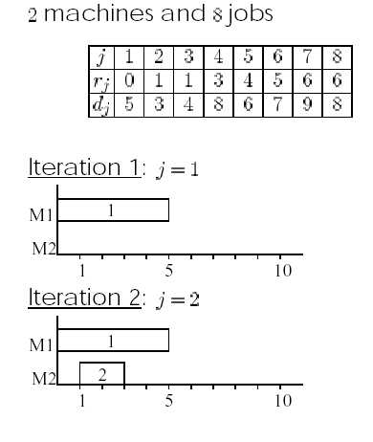
Reservation Systems without Slack Identical Weights and Machines Example
J={1}
J={1,2}

Slide 10
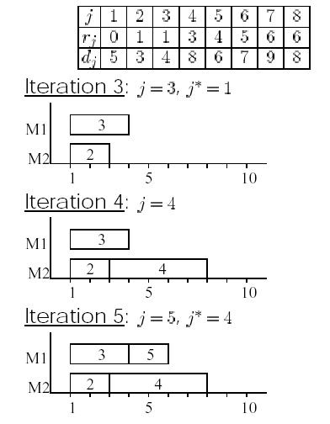
Reservation Systems without Slack Identical Weights and Machines Example
no…J={2,3}
J={2,3,4}
J={2,3,4,5}

Slide 11
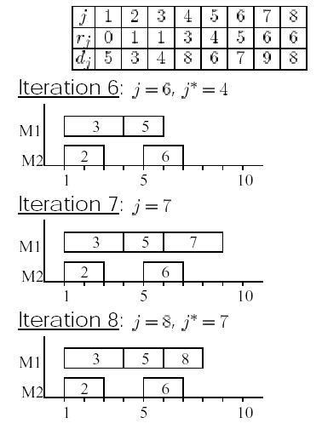
Reservation Systems without Slack Identical Weights and Machines Example
no…J={2,3,5,6}
J={2,3,5,6,7}
J={2,3,5,6,7,8}

Slide 12
Reservation Systems without Slack Unlimited Number of Machines
No slack, arbitrary processing times, equal weights, identical machines
Infinitely many machines in parallel
Minimize the number of machines used to process all jobs
Easily solved by following algorithm:
Order jobs by increasing r_{j}
Assign job 1 to machine 1
Suppose first j -1 jobs have been processed
Try to assign j th job to a machine in use
If not possible assign to a new machine
Graph theory: node coloring problem

Slide 13
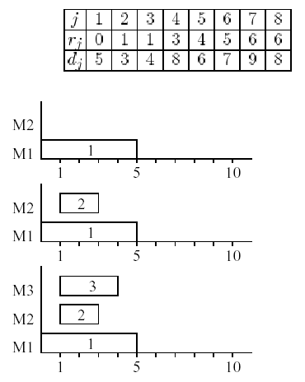
Reservation Systems without Slack Unlimited Number of Machines Example

Slide 14
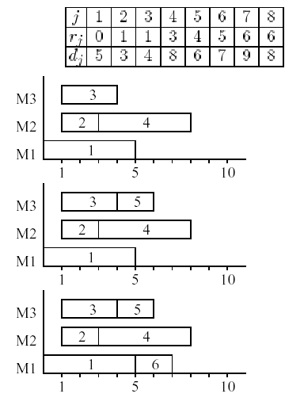
Reservation Systems without Slack Unlimited Number of Machines Example

Slide 15
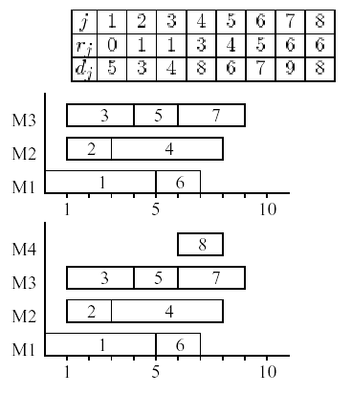
Reservation Systems without Slack Unlimited Number of Machines Example

Slide 16
Reservation Systems with Slack
Now allow slack
Trivial case
all processing times = 1, identical weights, identical machines
decomposition in time possible in this case
Now assume processing times are equal to some p ≥ 2
Interaction between time intervals
Barriers algorithm B. Simons, “Multiprocessor Scheduling of Unit-time Jobs with Arbitrary Release Times and Deadlines”, SIAM J. of Computing, Vol. 12, No. 2, May 1983
wait for critical jobs to be released
otherwise, start the job with the earliest deadline
Slot number l = l th job to start
S (l ) starting time of l th slot

Slide 17
Reservation Systems with Slack Barrier Algorithm
Slot
number
Barrier
ordered pair (l ,r )
constraint : job in slot l can not start before r
k-partial schedule: jobs inserted in first k slots
Starting with a k-partial schedule
construct a (k +1)-partial schedule, if possible
otherwise, add a new barrier to the barrier list L_{b} and start over from scratch
Release
time

Slide 18
Reservation Systems with Slack Earliest Deadline with Barriers
Selects machine h for job in (k+1)st slot
Compute the starting time

Slide 19
Reservation Systems with Slack Computing the Starting Time
Let τ be the earliest time the job can start
Minimum
release date
of jobs left
actually…
(k+1)mod(m)

Slide 20
Reservation Systems with Slack Selecting a Job
Select for (k+1)th slot job j ’ with the earliest deadline d_{j’}
If , creation of (k+1) partial schedule was successful
Otherwise a ‘crisis’ occurred and job j ’ is a ‘crisis job’
Crisis routine
Backtrack to find job with the latest starting time such that the deadline is greater than the crisis job deadline
If no such job, optimal schedule does not include crisis job j’
Otherwise this job is a pull job , found in slot l_{p}
Add new barrier with the minimum release time r* of all the jobs J_{r} after the pull job
Start over with ( l_{p} , r* ) added to the barrier list

Slide 21
Reservation Systems with Slack Barriers Algorithm Example: 2 machines, 4 jobs
Processing time p = 10

Slide 22
Reservation Systems with Slack Barriers Algorithm Example: 2 machines, 4 jobs
L_{b}=Φ
τ=0 , J₁ has r₁=0 , both machines available , J₁ ⇒ m₁[0,10]
τ=r₂=2 , machine 2 available , J₂ ⇒ m₂[2,12]
τ=max{t₁, t₂, t₃, t₄}={2, 5, 10, 0}=10
J₃ and J₄ available , d₃=19<d₄=30 , J₃ selected
C₃=10+10=20>19 ⇒ J₃ a “crisis job”
Crisis job
Machine 1
Machine 2
1
3
Pull job
2
0 10 20 30

Slide 23
Reservation Systems with Slack Barriers Algorithm Example: 2 machines, 4 jobs
“Pull job” J₂ has highest slot number with d_{j} >19
Restricted set J_{r}={3} , r₃=5 , L_{b}={(2,5)}
Start over…
τ=0… J₁ has r₁=0 , both machines available , J₁ ⇒ m₁[0,10]
τ=max{0, 2, 0, 5} , S(2)=5 on machine 2
All 3 remaining jobs available at t=5… pick job with earliest d_{j} ⇒ J₃
J₃ ⇒ m₂[5,15] , C₃=15<d₃=19 , no crisis
τ=max{5, 5, 10, 0} , S(3)=10 on machine 1
J₂ and J₄ available , d₂=d₄=30… pick J₂
τ=10+10=20 < d₂=30 , J₂ ⇒ m₁[10,20] , no crisis
τ=max{10, 5, 15, 0} , S(4)=15 on machine 2
τ=15+10=25 < d₄=30 , J₄ ⇒ m₂[15,25] , no crisis

Slide 24
Reservation Systems with Slack Barriers Algorithm Example: 2 machines, 4 jobs
Second iteration:
Machine 1
Machine 2
1
2
3
4
0 10 20 30
Optimal Schedule

Slide 25
Reservation Systems with Slack Generalizations
Non-identical processing times
NP-hard
No efficient algorithm exists
Need heuristics
Composite dispatching rule
Preprocessing: gather information on the flexibility of jobs and machines
Let ψ_{ik} be the number of jobs that can be processed on machine i in the slot [k-1,k]
Let M_{j} be the set of machines job j can be processed on
Dispatch least flexible job first on the least flexible machine, etc

Slide 26
Reservation Systems with Slack Priority Indices
Priority index for jobs
Priority index for machines
Low values =
high priority

Slide 27
Reservation Systems with Slack Algorithm to Max Weighted Number of Jobs
Step 0
Calculate both priority indices
Order jobs according to job priority index (I_{j})
Step 1
Set j=1
Step 2
For job [j] select the machine and time slot with lowest rank
Discard job [j] if it cannot be processed at all
Step 3
If j=n , STOP ; otherwise set j=j+1 and go back to Step 2

Slide 28
Reservation Systems with Slack Algorithm to Max Weighted Number of Jobs
Example: 4 jobs, 3 machines
I(j) = l M_{j} l² / (w_{j} / p_{j})
g(i,k) = max { Ψ(i,k+1), … , Ψ(i,k+p_{j}) }
Step 0 :
job j | 1 | 2 | 3 | 4
p_{j} | 2 | 3 | 4 | 2
w_{j} | 5 | 2 | 5 | 7
r_{j} | 1 | 2 | 3 | 4
d_{j} | 5 | 5 | 8 | 8
M_{j} | {1,2,3} | {1,2} | {1,3} | {1}
I(j) | 3²/(5/2)=3.6 | 2²/(2/3)=6 | 2²/(5/4)=3.2 | 1/(7/2) =.28

Slide 29
Reservation Systems with Slack Algorithm to Max Weighted Number of Jobs
Potential job need for machines within job [r_{j} , d_{j}]
 | M_{j} | 1 | 2 | 3 | 4 | 5 | 6 | 7 | 8
job 1 | 1,2,3
job 2 | 1,2
job 3 | 1,3
job 4 | 1
mach 1 |  | 0 | 1 | 2 | 3 | 4 | 2 | 2 | 2
mach 2 |  | 0 | 1 | 2 | 2 | 2 | 0 | 0 | 0
mach 3 |  | 0 | 1 | 1 | 2 | 2 | 1 | 1 | 1

Slide 30
Reservation Systems with Slack Algorithm to Max Weighted Number of Jobs
Step 0 (cont.)
job priority index order : 4 - 3 - 1 - 2
Step 1 :
pick first job from list : job 4
time k | 0 | 1 | 2 | 3 | 4 | 5 | 6 | 7 | 8
Ψ(1,k) |  | 0 | 1 | 2 | 3 | 4 | 2 | 2 | 2
Ψ(2,k) |  | 0 | 1 | 2 | 2 | 2 | 0 | 0 | 0
Ψ(3,k) |  | 0 | 1 | 1 | 2 | 2 | 1 | 1 | 1

Slide 31
Reservation Systems with Slack Algorithm to Max Weighted Number of Jobs
Step 2 :
p₄ = 2 must be accomplished in slots [5,6,7,8]
M₄ = {1} , g(1,4) = 4 g(1,5) = 2 g(1,6)=2
job 4 --> m₁[7,8]
Step 3 :
pick job 3 from list
Step 2 :
p₃ = 4 must be accomplished in slots [4,5,6,7,8]
M₃ = {1,3} , check g(1,3), g(1,4), g(3,3), g(3,4)
m₁ excluded because of job 4 conflict
g(3,3)=max{2,2,1,1}=2, g(3,4)=max{2,1,1,1}=2 pick k=4
job 3 --> m₃[5,6,7,8]
time k | 0 | 1 | 2 | 3 | 4 | 5 | 6 | 7 | 8
Ψ(1,k) |  | 0 | 1 | 2 | 3 | 4 | 2 | 2 | 2
Ψ(2,k) |  | 0 | 1 | 2 | 2 | 2 | 0 | 0 | 0
Ψ(3,k) |  | 0 | 1 | 1 | 2 | 2 | 1 | 1 | 1

Slide 32
Reservation Systems with Slack Algorithm to Max Weighted Number of Jobs
Step 3 :
pick job 1 from list
Step 2 :
p₁ = 2 must be accomplished in slots [2,3,4,5]
M₁ = {1,2,3} , check g(i,1), g(i,2), g(i,3) for i = 1,2 and
g(3,1), g(3,2)
g(i,k):
job 1 --> m₃[2,3]
time k | 0 | 1 | 2 | 3 | 4 | 5 | 6 | 7 | 8
Ψ(1,k) |  | 0 | 1 | 2 | 3 | 4 | 2 | 2 | 2
Ψ(2,k) |  | 0 | 1 | 2 | 2 | 2 | 0 | 0 | 0
Ψ(3,k) |  | 0 | 1 | 1 | 2 | 2 | 1 | 1 | 1
k | 1 | 2 | 3
m₁ | 2 | 3 | 4
m₂ | 2 | 2 | 2
m₃ | 1 | 2 | ----
pick m₃ and k=1

Slide 33
Reservation Systems with Slack Algorithm to Max Weighted Number of Jobs
time k | 0 | 1 | 2 | 3 | 4 | 5 | 6 | 7 | 8
Ψ(1,k) |  | 0 | 1 | 2 | 3 | 4 | 2 | 2 | 2
Ψ(2,k) |  | 0 | 1 | 2 | 2 | 2 | 0 | 0 | 0
Ψ(3,k) |  | 0 | 1 | 1 | 2 | 2 | 1 | 1 | 1
Step 3 :
pick job 2 from list
Step 2 :
p₂ = 3 must be accomplished in slots [3,4,5]
M₂ = {1,2} , check g(1,2)=4, g(2,2)=2
job 2 → m₂[3,4,5] …but m₁[3,4,5] eliminates need for m₂
slot | 1 | 2 | 3 | 4 | 5 | 6 | 7 | 8
m₁ |  |  |  |  |  |  | 4 | 4
m₂ |  |  | 2 | 2 | 2
m₃ |  | 1 | 1 |  | 3 | 3 | 3 | 3

Slide 34
Timetabling
Infinite identical machines in parallel
All of n jobs must be processed
Tooling constraints
Many tools
Need one or more tools for each job
Resource constraints
Single resource of quantity R
Need certain amount for each job

Slide 35
Timetabling Resource Constraints
One type of tool but R units of it (resource)
Job j needs R_{j} units of this resource
Clearly, if R_{j} + R_{k} > R then job j and k cannot be processed at the same time, etc
Applications
scheduling a construction project (R=crew size)
exam scheduling (R=number of seats)
Workforce capacity
n activities
An infinite number of resources
Each activity requires W_{j} workers
You only have W workers
Find a schedule that minimizes makespan

Slide 36
Special Case: Exam Scheduling
Timetabling Resource Constraints
All exams have the same duration
An exam room has capacity W
Course j has W_{j} students
All students in course j must write the exam at the same time
Find a timetable for all n exams in the minimum amount of time

Slide 37
Special Case = Bin Packing
Timetabling Resource Constraints
Pack the objects into the bins
to minimize the number of
bins that are used
W₈
W₃
W₆
W₇
W₅
W₄
W₁
W₂
…
W₈
W₅
W₁
W₆
W₃
W₂
W₇
W₄
Each bin has capacity = W

Slide 38
Timetabling Solving the Bin-Packing Problem
First fit (FF) heuristic
Always put an item in the first bin it fits into
Worst case bound:
Example: Assume 18 items and R=2100
Jobs 1-6 require 301 resources
Jobs 7-12 require 701 resources
Jobs 13-18 require 1051 resources
FF heuristic:
We assign the first 6 jobs to one interval (301⋅6=1806)
We then assign jobs two at a time to next 3 intervals (701⋅2=1402)
We then assign just one of the remaining jobs to each interval
Very poor performance due to initial order of jobs

Slide 39
First Fit Decreasing (FFD)
Timetabling Solving the Bin-Packing Problem
An improvement of FF:
Order jobs in decreasing order of R_{j} first
Worst case bound
FF and FFD can be extended to arbitrary release dates

Slide 40
Timetabling Solving the Bin-Packing Problem
activities | 1…6 | 7…12 | 13…18
W_{j} | 301 | 701 | 1051
First Fit Decreasing Example:
order jobs of FF example in decreasing R_{j} order
Job List: 13,…,18,7,…,12,1,…,6
W = 2100
bin 1 | 13[1051] | 14[1051] | 7[701] | 8[701] | 1[301] | 2[301]
bin 2 | 14[1051] | 8[701] | 2[301]
bin 3 | 15[1051] | 9[701] | 3[301]
bin 4 | 16[1051] | 10[701] | 4[301]
bin 5 | 17[1051] | 11[701] | 5[301] |  | optimal
bin 6 | 18[1051] | 12[701] | 6[301] |  | solution

Slide 41

People are Different…
Timetabling Operator or Tooling Constraints
So far we have been assuming that we have W people that are all equivalent
Any set of W_{j} people could do activity j
Obviously this isn’t true in many applications
E.g., Medical or language specialties
The operator has to have specific skills to do the activity
Able to speak French, certified accountant
A specific tool is needed
1/8” drill bit, refrigerator truck
If two activities require the same operator or tool, they cannot be done at the same time

Slide 42
Timetabling Tooling Constraints
One of each tool
Objective: minimize makespan
Special case of resource-constrained project scheduling problem with one of each resource, that is, R_{i} = 1, and no precedence constraints
NP-hard
Assume all processing times = 1 … no efficient algorithms exist
Equivalent to node coloring problem

Slide 43
Timetabling Tooling Constraints
Node Coloring Problem
Job = node
Jobs need same tool = arc between nodes
Feasibility problem:
Can the graph be colored with H colors (timeslots) ?
Optimization problem:
What is the lowest number of colors needed?
Chromatic number of the graph

Slide 44
Mapping from Graph Coloring to Timetabling
Timetabling Tooling Constraints
Nodes are activities
Arcs mean the activities require the same resource
Colors are time slots
Minimizing the number of colors is minimizing makespan

Slide 45
Timetabling Tooling Constraints
Closely related to reservation problem with zero slack and arbitrary processing times
Special case of timetabling problem
tools in common = overlapping time slots
tools in common ⇒ nodes connected
colors = machines
minimizing colors = minimizing machines
adjacent time slots in reservation problem
vs tools need not be adjacent in timetabling problem (thus, a harder problem)

Slide 46
Reservation Systems without Slack Node Coloring Problem
Consider a graph with n nodes
If an arc (j,k) connects nodes j and k , they cannot be colored with the same color
jobs which overlap have to be on different machines
How many colors do we need to color the graph?
Number of colors needed = Number of machines needed
Node coloring characterization provides linkage to Timetabling Problem with Tool Constraints

Slide 47
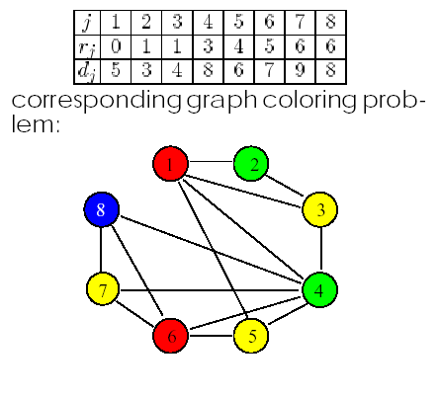
Reservation Systems without Slack Node Coloring Problem
Example formulated as Node Coloring Problem

Slide 48
Variable and Value Ordering Heuristics
Many heuristics exist for graph coloring
degree of node = number of arcs connected to node
saturation level = number of colors connected to node
Intuition:
Color high degree nodes first
Color high saturation level nodes first
How do you pick a node (variable) to color next?
Smallest domain first
Maximum forward degree
How do you pick a color (value) for that node?
Randomly
Lexicographically
Order colors and assign the lowest possible

Slide 49
Timetabling Graph Coloring Heuristic
Step 1
Order nodes in decreasing order of degree
Step 2
Use color 1 for first node
Step 3
Choose uncolored node with maximum saturation level, breaking ties according to degree
Step 4
Color using the lowest possible number color
Step 5
If all nodes colored, STOP; otherwise go back to Step 3

Slide 50
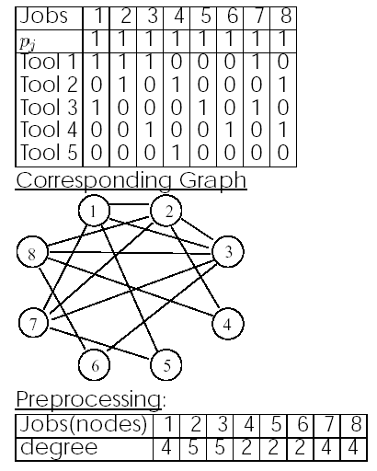
Timetabling Graph Coloring Heuristic Example

Slide 51
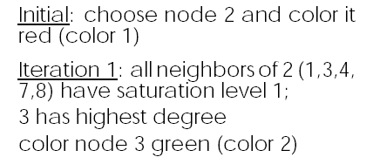
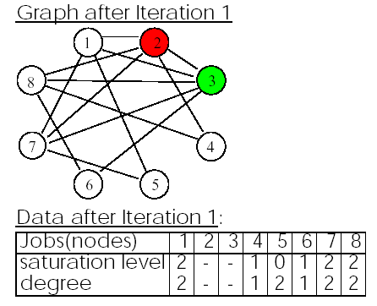
Timetabling Graph Coloring Heuristic Example
# connections to
uncolored nodes

Slide 52
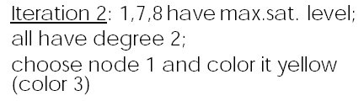
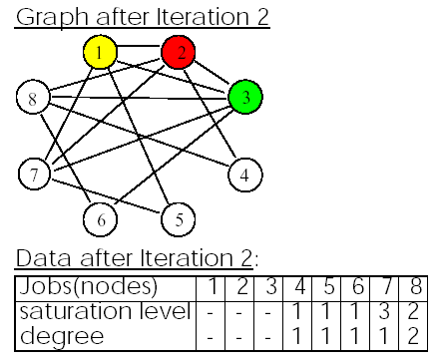
Timetabling Graph Coloring Heuristic Example

Slide 53

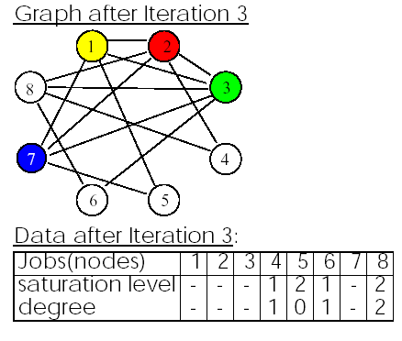
Timetabling Graph Coloring Heuristic Example

Slide 54

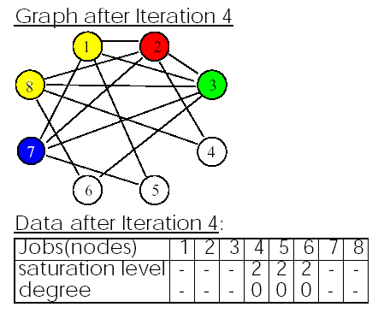
Timetabling Graph Coloring Heuristic Example

Slide 55
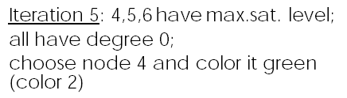
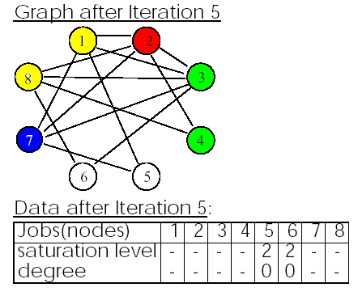
Timetabling Graph Coloring Heuristic Example

Slide 56
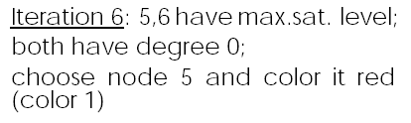
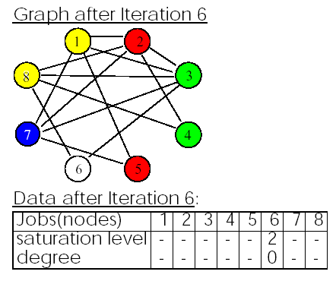
Timetabling Graph Coloring Heuristic Example

Slide 57

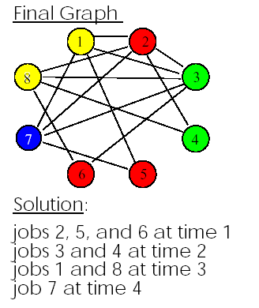
Timetabling Graph Coloring Heuristic Example

Slide 58
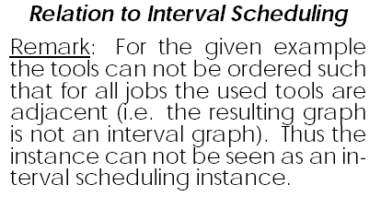
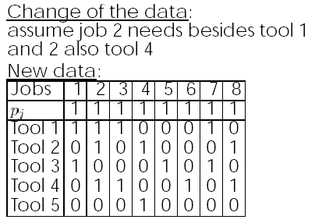
Timetabling Graph Coloring Heuristic Example

Slide 59
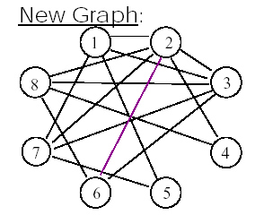
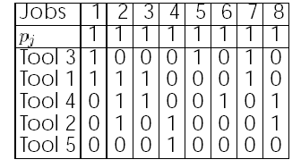
Timetabling Graph Coloring Heuristic Example
Tool Renumbering:

Slide 60
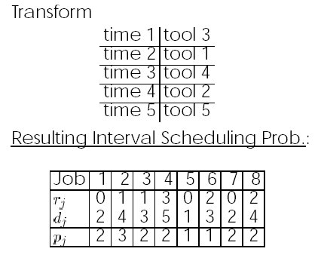

Timetabling Graph Coloring Heuristic Example

Slide 61
Timetabling Problem Equivalence Example
Suppose now we have a reservation system:

Slide 62
Timetabling Equivalent Timetabling Problem
Job 1 must
be processed
in time [0,2]
Job 2 must
be processed
in time [2,5]

Slide 63
Timetabling Scheduling Meetings Example
Schedule 4 people to attend a subset of 5 meetings
meetings = jobs and people = tools
all meetings are one hour

Slide 64
Corresponding Graph
Timetabling Scheduling Meetings Example
Degree =4
2
Degree =4
Degree =2
1
3
5
4
Degree =3
Degree =3

Slide 65
Timetabling Scheduling Meetings Example
Can select either job 1 or 2 first
Say, select 1 and color with the first color
2
Saturation level = 1
for every node
1
3
Degree =4
⇒ Select 2 because
highest degree
2
Degree =4
1
3
Degree =2
5
4
5
4
Degree =3
Degree =3

Slide 66
Timetabling Scheduling Meetings Example
Color Job 2 with the next color
2
Saturation level = 2
for every node
1
3
⇒ Select 4 because
highest degree
Degree =4
5
4
2
Degree =4
1
3
Degree =2
5
4
Degree =3
Degree =3

Slide 67
Timetabling Scheduling Meetings Example
Color Job 4 with the next color
2
Saturation level =
2 for node 3
3 for node 5
1
3
⇒ Select 5 next
Degree =4
5
4
2
Degree =4
1
3
Degree =2
5
4
Degree =3
Degree =3

Slide 68
Timetabling Scheduling Meetings Example
Color Job 5 with the next color
2
1
3
5
4
⇒ Select 3 next

Slide 69
Timetabling Scheduling Meetings Example
Color Job 3 with same color as Job 4
2
1
3
5
4
Had to use 4 colors ⇒ Makespan = 4

